Slide 1
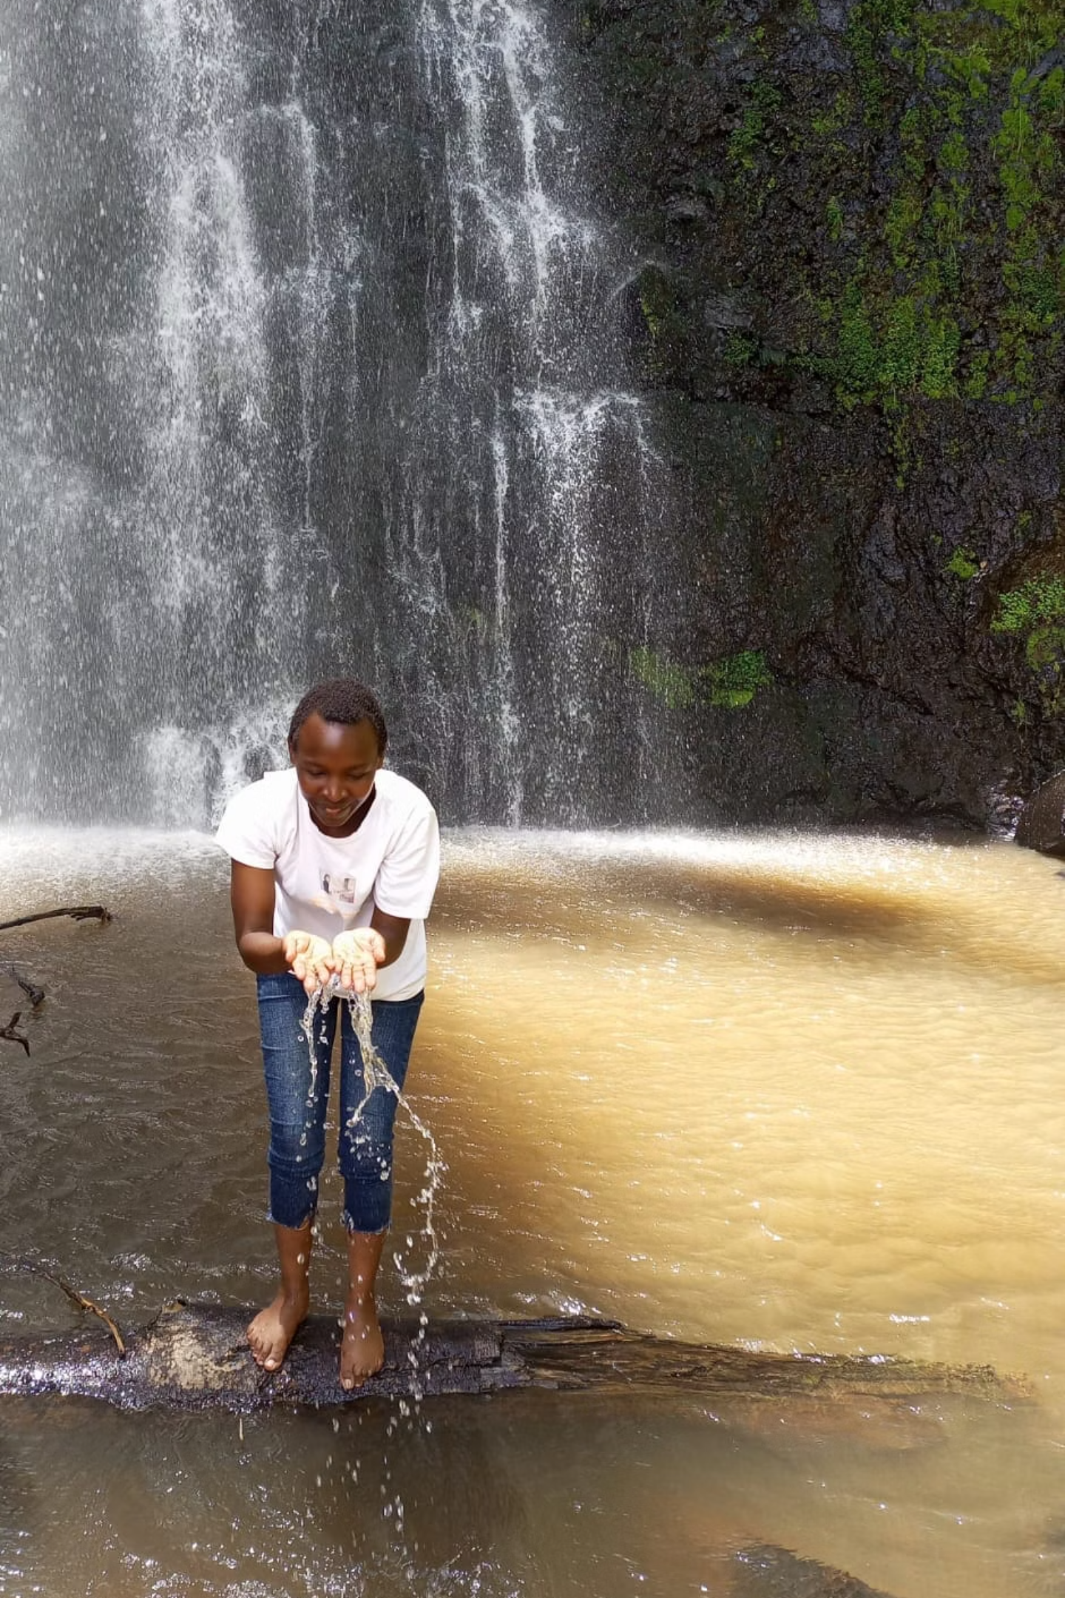
Faith Chebet: A Journey of Growth and Purpose
Born in the serene highlands of Kericho County, Kenya, my life has been shaped by family values, educational pursuits, and creative passions. This is the story of my journey from rural Kiptere to becoming a Computer Science student at Dedan Kimathi University of Technology.

Slide 2
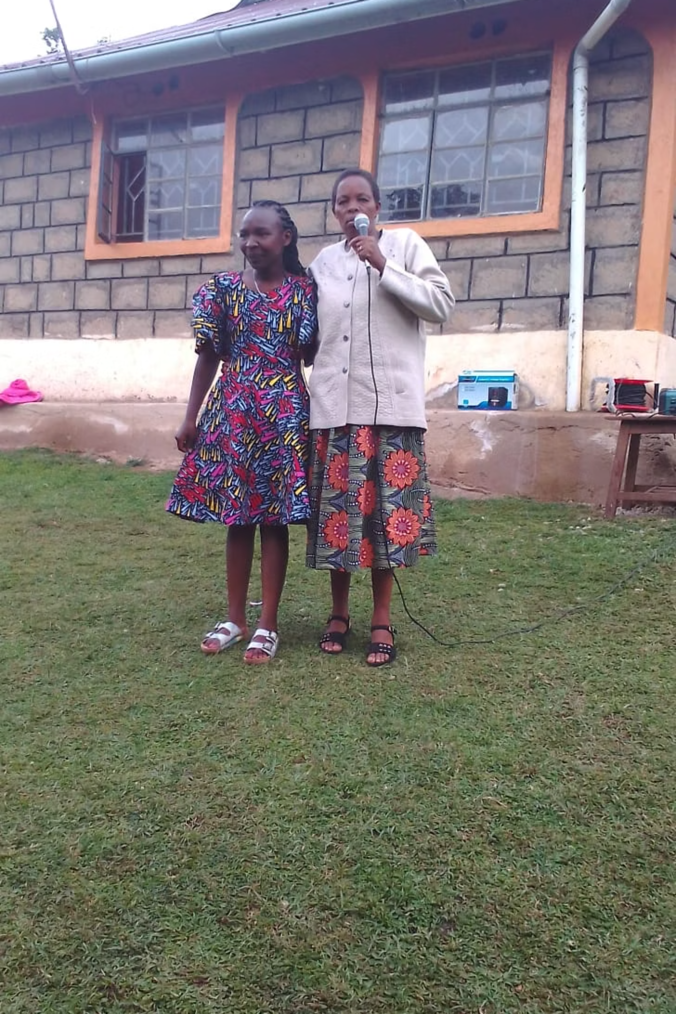
Early Life in Kiptere
1
Birth & Family
Born on June 24, 2003, in Kiptere, Kericho County, as the firstborn to Geofry and Jeniffer Ruto. I have three siblings: Kelvin, Sandra, and Ashly.
2
Grandparents' Influence
From 2006-2011, I lived with my grandparents Mary and Alfred Koskei, who instilled in me values of humility, hard work, and faith through daily chores and evening prayers.
3
Return to Parents
In 2011, I returned to my parents' home, where my father taught me diligence and determination, while my mother instilled kindness, courage, and consistency.

Slide 3




Educational Journey
St. Peters Primary
Tinderet Educational Center
PP1 through Class 6, where I discovered my natural inclination toward learning and curiosity.
Completed primary education from Class 6 to 8, developing resilience and discipline in a more challenging academic environment.
Kapsabet Girls High School
Dedan Kimathi University
Excelled academically, consistently ranking among the top ten students while balancing studies and extracurricular activities.
Currently pursuing a Bachelor of Science in Computer Science, discovering my passion for technology and problem-solving.

Slide 4

Passions and Creative Pursuits
Photography
Capturing moments, smiles, and landscapes to tell stories through images and observe details others might miss.
Graphic Design
Creating visual elements using Adobe Photoshop and other tools to deliver messages and provoke emotions.
Video Editing
Combining visual elements, color, motion, and sound using Premiere Pro, CapCut, and Filmora to create compelling narratives.
Web Development
Coding with HTML, CSS, JavaScript, and frameworks like React.js, plus backend work with Java and Spring Boot.

Slide 5








Values and Personality
Faith
Diligence
My Christian faith guides my actions, decisions, and worldview, serving as my beacon during uncertainty and my foundation during challenges.
Hard work is not just about productivity but a sign of appreciation for opportunities. Every task deserves full attention and effort.
Commitment
Excellence
Being dedicated to goals, vows, and obligations with time, effort, and character. Commitment gives shape to ambition and builds trustworthiness.
Striving continuously for the best in everything, not for perfection but to be better than yesterday in all aspects of life.
I am a cool, calm, and curious individual who enjoys the pursuit of growth, purpose, and knowledge. My personality is tempered by quiet strength, determination, and a desire to explore new ideas.

Slide 6
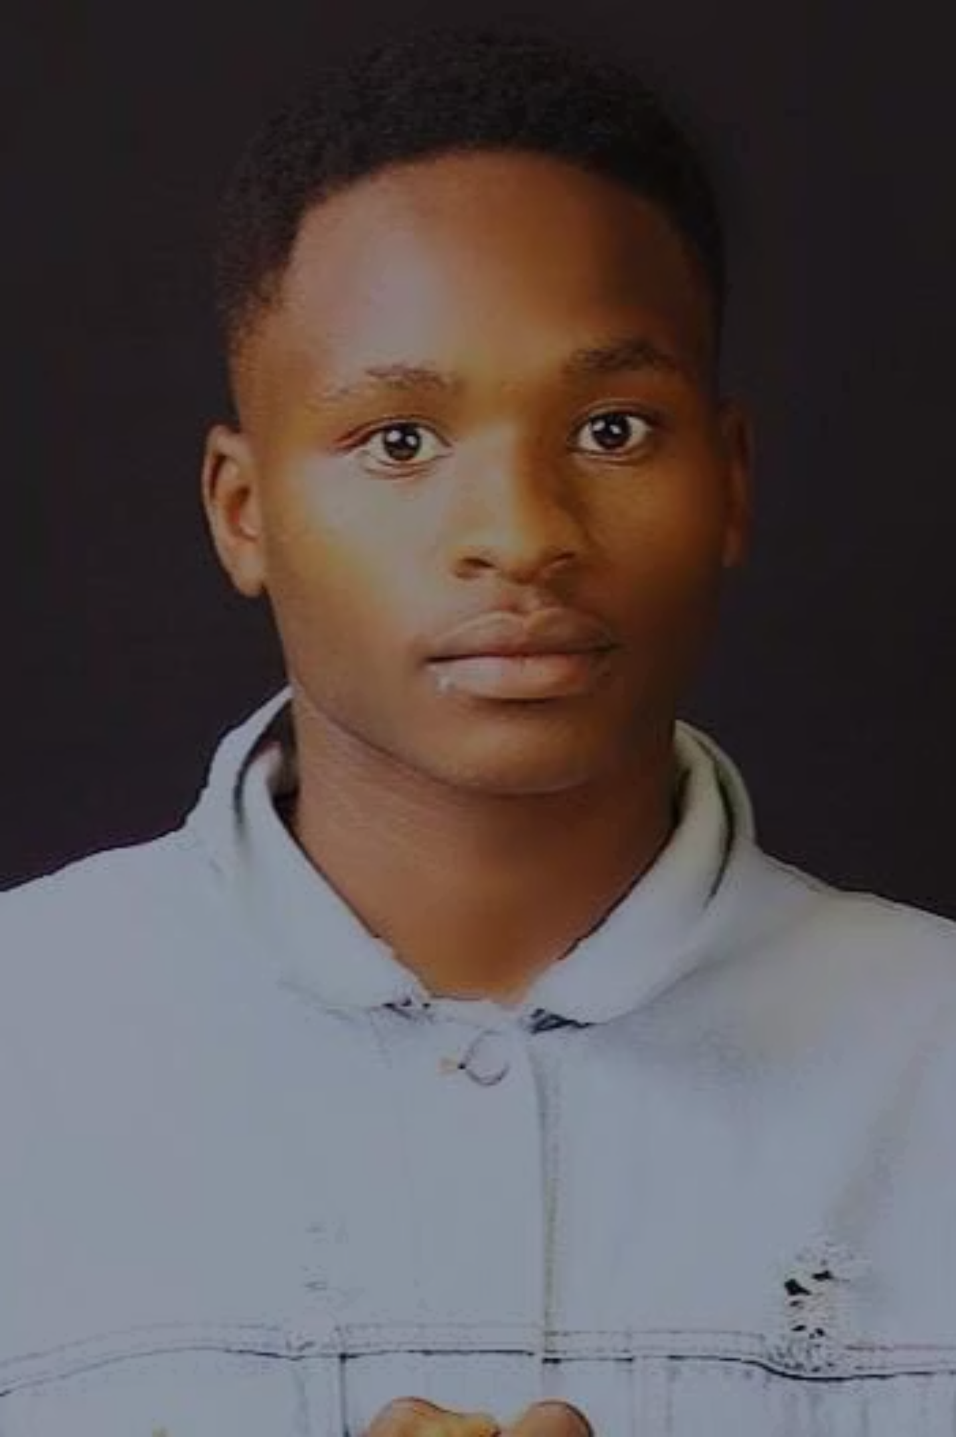
Influential Mentors
Calvince Omit
1
A dedicated educator who taught me that greatness comes from tenacity and perseverance, not just natural talent. He encouraged high standards and belief in my potential.
Brian Koton
2
A visual storyteller whose meticulous design work showed me that creativity comes from effort, constructive criticism, and relentless curiosity.
Don Kiptanui
3
A visionary graphic designer who taught me that design is communication, not decoration. His mentorship helped me silence my inner critic and build a meaningful portfolio.
Joel & Braxton
4
Media practitioners who demonstrated the power of storytelling across different formats and the importance of consistency, quality, and impact in content creation.

Slide 7
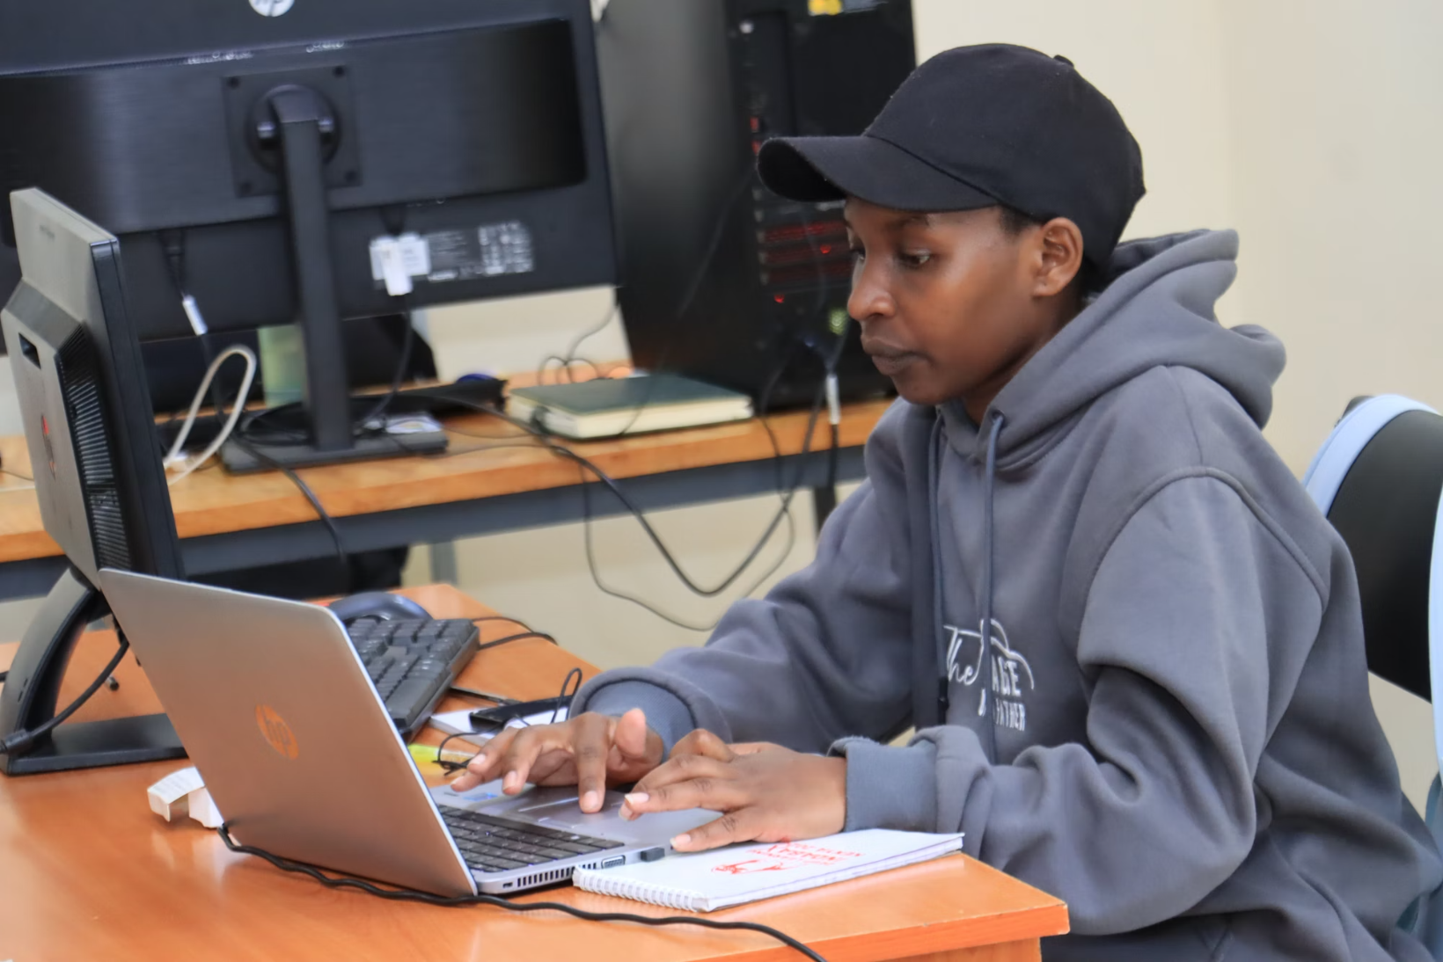
University Internship Experience
Laundry Management Software Project
Applied software development lifecycle from requirements to testing
Engaged with users to understand pain points
Developed frontend skills with HTML, CSS, JavaScript
Gained backend exposure through scripting and database administration
Hardware and Networking Experience
Performed PC troubleshooting and component replacement
Installed LANs and configured network devices
"A good technician fixes the problem; a great one avoids it." This internship transformed me from a classroom learner to a confident problem-solver with practical skills.
Learned network topology and IP configuration

Slide 8
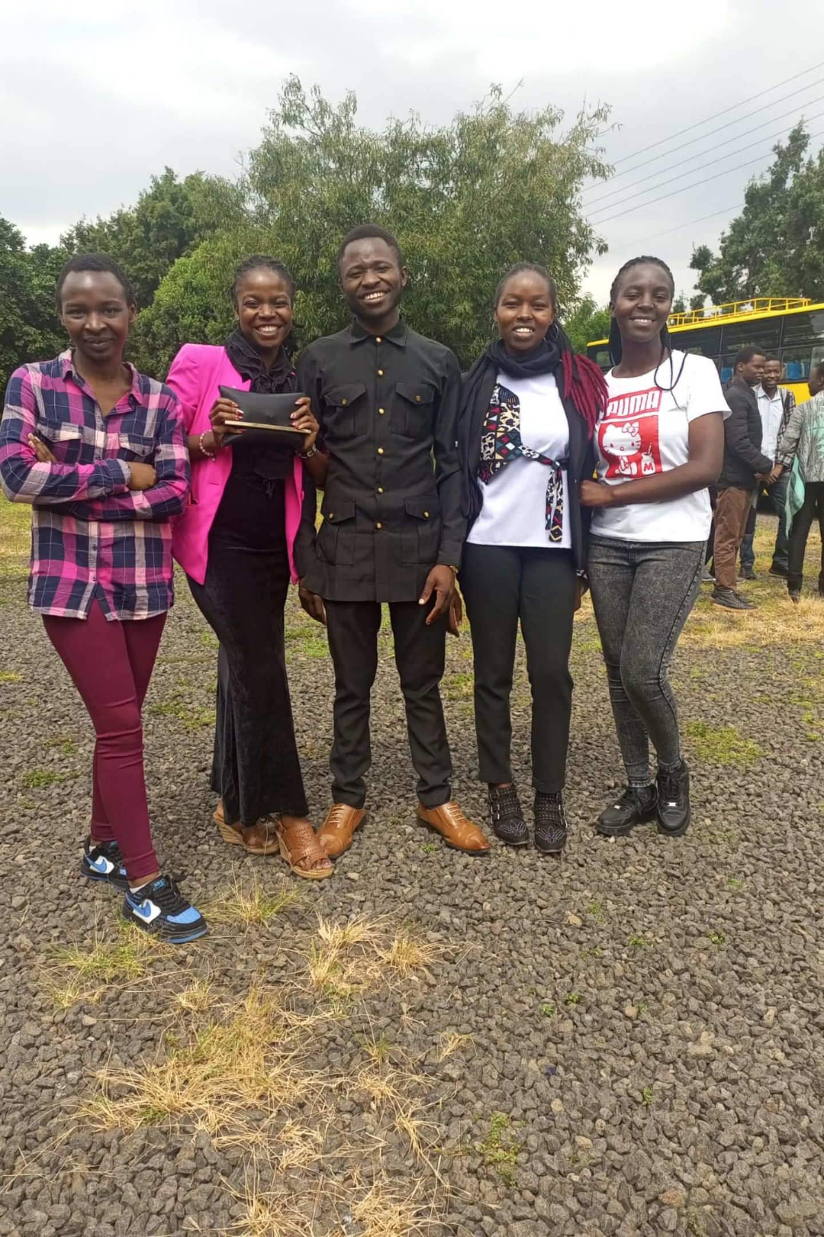
Social Life and Personal Growth
Community Connections
Nature Walks
I value genuine conversations and being present for others in moments of joy or hardship. Social relationships aren't just part of my life—they're part of who I am.
Rejuvenating walks with friends provide relief from academic pressures and strengthen bonds through shared adventures and discoveries.
Growth Through Challenges
University life taught me self-awareness, helping me identify strengths in creativity and critical thinking while improving weaknesses in public speaking and time management.

Slide 9





Future Aspirations
Software Designer
1
Create applications that solve real problems
2
Digital Design Studio
Establish a space where technology and imagination intersect
3
Women in Tech Advocate
Launch programs to boost confidence and skills of girls in STEAM fields
4
Community Technology Center
Create a space where rural youth can learn to code, design, and build companies
5
Global Impact
Partner with organizations focused on sustainable development and digital inclusion
My vision is to use technology not just as a tool for advancement but as a force for transformation, particularly for underrepresented groups in rural communities like my village, Kiptere.

Slide 10
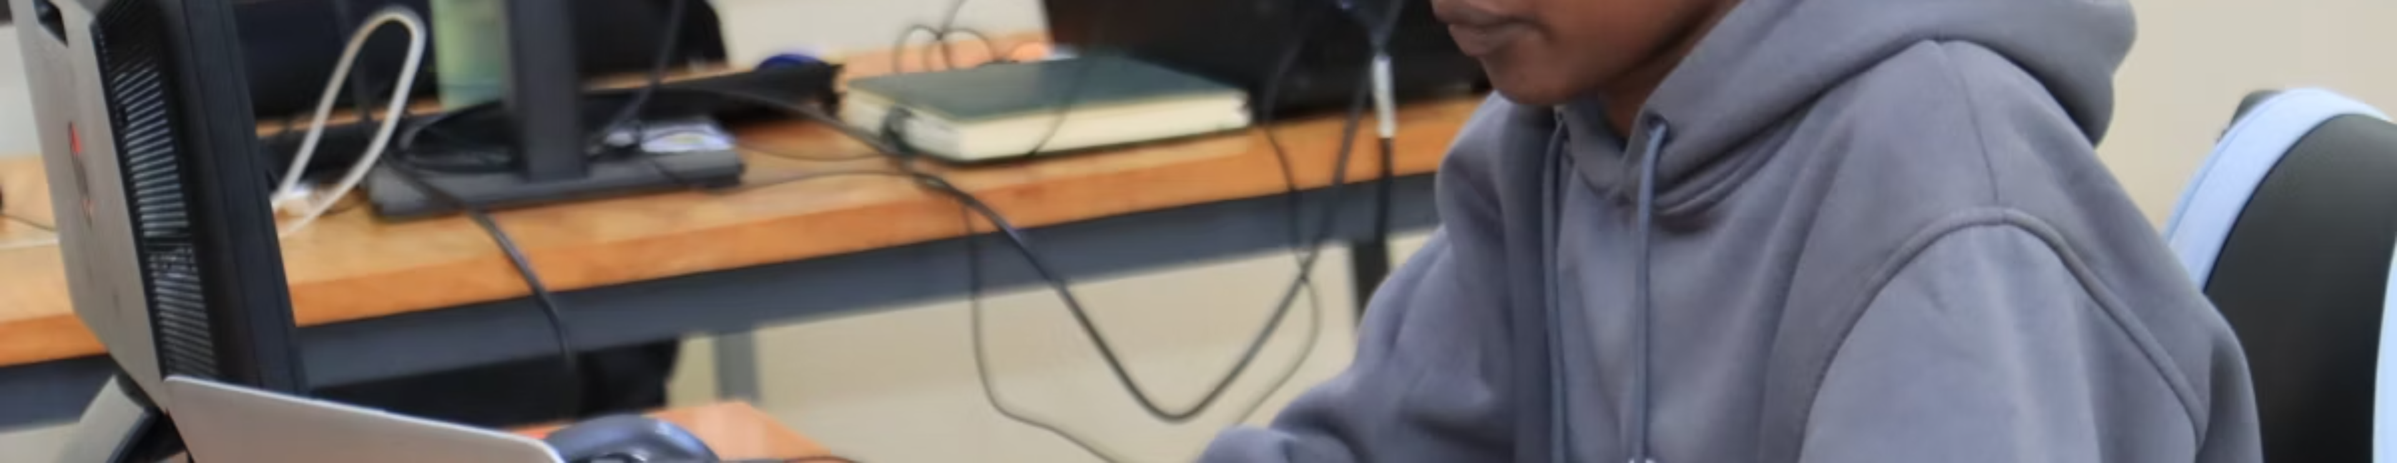
A Life of Purpose
My story is one of growth, passion, and purpose—from the green highlands of Kiptere to the technological frontiers of computer science. While there is still much to learn and achieve, I am confident that my path is guided by faith, curiosity, and resilience.
This autobiography is just a chapter in a book that continues to be written every day. My hope is that it inspires others to reflect on their journeys, pursue excellence, and remain true to themselves while making a positive impact on their communities.

